Slide 1
Brian Hansen brian@tf3604.com @tf3604
Visualize Your Transaction Log
SQL Saturday #662
Sioux Falls, South Dakota
19 August 2017

Slide 2



Brian Hansen
15+ Years working with SQL Server
Development work since 7.0
Administration going back to 6.5
Fascinated with SQL internals
brian@tf3604.com
@tf3604.com
children.org
www.tf3604.com/log

Slide 3
Agenda
Purpose of the transaction log
Organization of the transaction log
Flushing & clearing the log / checkpoints
Rollback operations
VLF fragmentation
Log monitoring

Slide 4
Purpose of the Transaction Log
Primary purposes
Durability
Write-ahead logging
Crash recovery / restore operations
Atomicity
Thought experiment
What would SQL be like without a transaction log?
Secondary purposes
Log reader (replication, CDC)
Mirroring / Availability Groups / log shipping
Snapshots

Slide 5
What Goes in the Transaction Log?
Everything that modifies the state any database in SQL
Includes data to redo an operation
Includes data to undo an operation
Very limited exceptions for some tempdb operations

Slide 6
Physical vs Logical Log File
Logical Log File
Always growing
Write once / read many
After being written, log records are never changed
Physical Log File
Only grows when full (or manually grown)
Divided into virtual log files (VLFs)
VLFs are inactivated when possible and over-written

Slide 7
Organization of the Transaction Log
The Transaction Log is just a file …

Slide 8
Organization of the Transaction Log
The Transaction Log is just a file …
With a bit of header information …

Slide 9
Organization of the Transaction Log
The Transaction Log is just a file …
With a bit of header information …
Then divided into Virtual Log Files.
Not necessarily of equal size

Slide 10
Virtual Log Files
VLFs can be in one of several statuses:
Inactive (never used)
Inactive (previously used)
Active (current)
Active (not usable)
Only one VLF is current at a time.

Slide 11
Virtual Log Files
VLFs can be in one of several statuses:
Inactive (never used)
Inactive (previously used)
Active (current)
Active (not usable)
Only one VLF is current at a time.
VLFs are numbered.

Slide 12
Virtual Log Files
As more records are added to the log, additional VLFs are allocated.

Slide 13
Virtual Log Files
As more records are added to the log, additional VLFs are allocated.

Slide 14
Virtual Log Files
As more records are added to the log, additional VLFs are put in use.
Writing to the log is circular so long as VLF are available.
What happens next?

Slide 15
Virtual Log Files
The log file has to grow
More VLFs are added

Slide 16
Virtual Log Files
The log file has to grow
More VLFs are added
Eventually the log will be “truncated” or “cleared”

Slide 17
Organization of the Transaction Log
VLFs are also structured

Slide 18
VLF Detail
Again there is a header
Then a series of log blocks
In 512 byte increments up to 60K in size

Slide 19
Log Block Detail
As expected, starts with a header
Then a series of log records
Completely variable in size
And an index to the log records (slot array)
Notes:
Limit of 24K per log record?

Slide 20
Log Record Detail
Of course, a header
Record type, transaction ID, length, pointer to previous transaction record, etc.
Payload
Before/after image of changes

Slide 21
Log Sequence Number
Each log record can be uniquely identified by its Log Sequence Number (LSN)
An LSN is composed of three parts
VLF number
Log Block offset (512-byte chunks, not necessarily contiguous)
Log Record number (slot number)
The LSN is, in a very real way, a pointer into the (logical) log file

Slide 22
LSN Representations
Four common ways to express an LSN
Format | Example | Common uses
Colon-separated (hexadecimal) | 000001c0:0000006b:0005 | Log management
Hexadecimal | 0x000001c00000006b0005 | Change data capture
Decimal | 448000000010700005 | Backup
Colon-separated (decimal) | 448:107:5 | Input to fn_dblog
These four LSNs are equivalent

Slide 23
Demo
LSN Converter

Slide 24
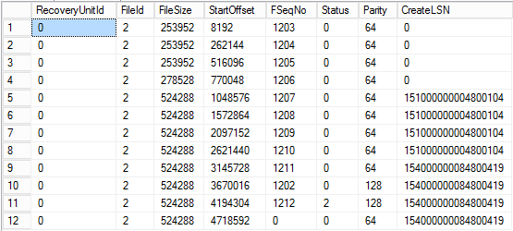
DBCC LOGINFO(‘db_name’)
Returns one row per VLF

Slide 25
Demo
DBCC LOGINFO
+ Log File Visualizer

Slide 26
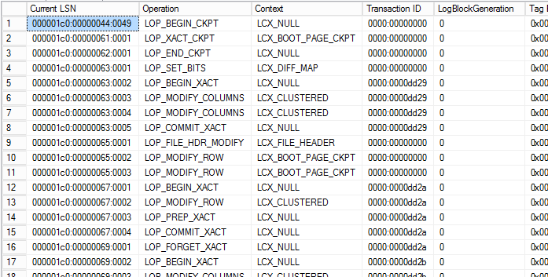
fn_dblog(start_lsn, end_lsn)
Returns one row per log record

Slide 27
Demo
fn_dblog

Slide 28
Related command/function
DBCC SQLPERF(LOGSPACE)
Log size, percent used per database
fn_dump_dblog
Similar to fn_dblog, but reads from backup file

Slide 29
Checkpoint
Process of writing dirty pages from the buffer pool to disk
Irrespective of transaction completion

Slide 30
Checkpoint Types
Automatic
Period background thread
Instance-wide [sp_configure 'recovery interval (min)', 2]
Indirect (2012+)
Database-specific
[alter database myDB set target_recovery_time = 2 minutes]
Off by default in 2012, 2014; on by default in 2016+
Internal
During operations such as backup, snapshots, shutdown
Manual
CHECKPOINT command

Slide 31
Checkpoint Process
Write to log: checkpoint start
Also info about any uncommitted transactions
Flush the log
Identify dirty pages; write to disk
Update boot page with LSN corresponding to checkpoint start
(If SIMPLE recovery) clear the log
Write to log: checkpoint finish

Slide 32
Flushing the Log
Flushing = closing a log block
Triggers
60K limit reached
Transaction commits
Transaction rollbacks
Checkpoint

Slide 33
Recovery Models
Impacts how SQL logs changes
Simple
Full
Bulk-logged

Slide 34
Simple Recovery Model
Commonly used for test systems or low-volume production systems
What is your recovery point objective?
All changes logged, but can be “discarded” on commit
Can only recover to the latest full backup

Slide 35
Full Recovery Model
Probably the most common recovery model for production systems
What is your recovery point objective?
Log records must be kept until log backup completed
Can recover to an arbitrary point in time

Slide 36
Bulk-logged Recovery Model
Not frequently used, perhaps temporarily during maintenance windows
What is your recovery point objective?
Similar to full model, but some changes are only “noted” rather than fully logged
Log backups still include all changes
Point-in-time recovery not possible

Slide 37
Clearing* the Log (aka Truncating*)
Marks unneeded portions of log as inactive
Triggers:
Simple recovery**: Checkpoint
Full/bulked-log: Log Backup
Change from Full or Bulked Logged to Simple***
Why can’t the log clear?
Pending log backup
Active replication / CDC / AG / mirroring
Long-running transaction
See sys.databases.log_reuse_wait_desc
* Horribly misnamed! This process clears nothing and truncates nothing.
** More technically, when in “auto-truncate” mode.
*** But this breaks the backup chain!
Notes:
Auto-truncate mode means that the database (1) is in the Simple recovery model, or no full database backup since changing to Full or Bulked Logged model.

Slide 38
Demos
Simple recovery
Full recovery

Slide 39
Rolling Back a Transaction
When a transaction cannot complete, it must rollback
ROLLBACK TRANSACTION command
Connection is abandoned
Network failure, KILL, severe errors, client crash
Non-graceful shutdown of SQL (crash recovery)
Restore operations
Rollback operations are single-threaded

Slide 40
Rolling Back a Transaction
Log records form a reverse linked list of operations within a transaction.
Let’s suppose the yellow transaction needs to roll back.
The first record is for “begin transaction.”

Slide 41
Rolling Back a Transaction
SQL Server finds the last log record for the transaction.
SQL reverses the operation in the buffer pool.

Slide 42
Rolling Back a Transaction
Creates a new log record indicating that the operation was undone. This is called a “Compensation” record (or “anti-operation”).
This record then points back to the second-to-last record.

Slide 43
Rolling Back a Transaction
The second to last operation is undone, and a compensation record is written that points back to the first record (the “begin transaction”).

Slide 44
Rolling Back a Transaction
Finally, an “abort transaction” log record is written. It also points back to the “begin transaction” record.

Slide 45
Rolling Back a Transaction
Key takeaways:
Rollback operations generate log records
As the initial operations are performed, SQL Server will “reserve” log space to ensure that a rollback is possible.
Very large DML operations will reserve a lot of log space (and will prevent the log from clearing while in process). Often better to split up into smaller transactions.

Slide 46
Demo
Rollback operations

Slide 47
Creating new VLFs
My transaction log grew. How many VLFs?
Log growth size | New VLFs created
1 to 64 MB | 4
64 MB to 1 GB | 8
Greater than 1 GB | 16
Special case for SQL 2014+
Compute current log size / growth amount
If greater than 8, add only 1 new VLF

Slide 48
VLF Trade-Offs
Too many VLFs create performance problems (“VLF Fragmentation”)
Slows noticeably any time log is read
Start-up time for database, log reader, backup & restore, etc.
But smaller VLFs are faster to allocate (zero-init)
Too few VLFs also create performance problems
Clearing the log, especially when long-running transactions are happening

Slide 49
Pre-Allocating the Log
Why?
Eliminate VLF fragmentation
Avoid log growth during user operations
Can be time-consuming due to zero-initialization
However, plan for auto-growth
Set reasonable auto-growth parameters
Fixed growth amount, not percentage

Slide 50
Demo
VLF Fragmentation

Slide 51
Log Monitoring
Watch your VLF count
Monitor log size over time
Set SQL Alerts on:
Severity 17 errors (will alert on log full)
Error 5145
Autogrow of file '…' in database '…' was cancelled by user or timed out after xx milliseconds.
Error 5144
Autogrow of file '…' in database '…' took xx milliseconds.

Slide 52
Log Monitoring, continued
PerfMon counters
One row per counter per database (plus rollup)
Paul Randal explains what to look for.
select object_name, counter_name, instance_name, cntr_value
from sys.dm_os_performance_counters
where counter_name in ('Log Growths', 'Log Shrinks', 'Percent Log Used', 'Log Flush Waits/sec', 'Log Bytes Flushed/sec', 'Log Flushes/sec');

Slide 53

Thank You
This presentation and supporting materials can be found at www.tf3604.com/log.
Slide deck
Scripts
Sample database
SQL Server Log File Visualizer
& LSN Converter binaries
& source
brian@tf3604.com • @tf3604
Have a happy eclipse

